Slide 1

Web
Development
Page
01

Slide 2

what is
Web Development?
Web development : process of building, programming and maintaining websites and web applications.
web development we can develop:
Front-end: The surface level elements and things you can see in the user's browser like page layout, color schemes, etc.
Back-end: This is where you put all the technical elements behind the scenes of your site
full stack : the complete process of application software development, including both the front-end and back-end development
Page
02

Slide 3
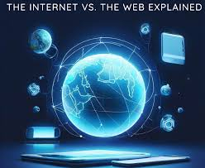
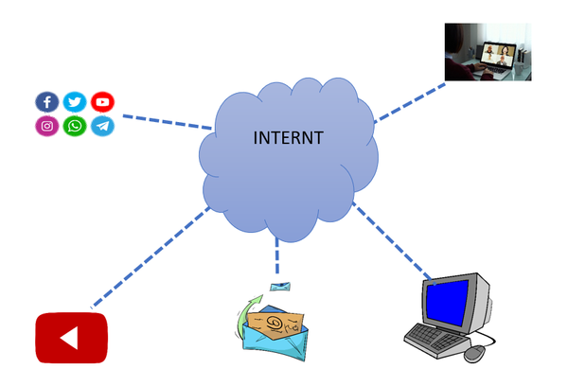
The difference between
2024
the Web and the internet
What is WWW (Web)?
WWW definition: WWW (World Wide Web) is one of the various services offered by the Internet in order to share information
What is the Internet?
Internet definition: The Internet is a network of networks, connected computers, servers, and countless devices from around the world on which the (WWW) web runs.
Page
03

Slide 4
Internet is an infrastructure, whereas WWW is a service.
WWW is more software-oriented, but the Internet is primarily based on hardware.
WWW is a subset of the Internet. On the other hand, the Internet is a superset of WWW.
The Internet is independent, whereas WWW’s existence depends on the Internet.
WWW is one of the various services offered by the Internet in order to share information. On the other hand, the Internet is a network of connected computers on which the web (WWW) runs.
Key differences
between the web and the internet
Page
04

Slide 5
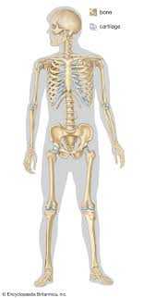
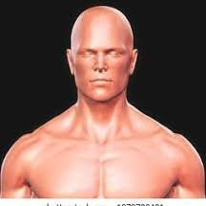
Jobs in
Web development
Full-stack
A full-stack web developer is a person who can develop both client and server software.
Full stack is divided into two parts :
A- front-end
1-html:
-hyper text markup language
-using for creating web pages and describe the structure of web pages.
2-css:
- CSS stands for Cascading Style Sheets
-describes how HTML elements are to be displayed on screen
3-javascript :programming language that allows you to implement complex features on web pages
Page
08

Slide 6
Jobs in
Web development
B- backend:
Server software:
1-php:
-stand for Hypertext Preprocessor
- scripting language
-PHP scripts are executed on the server (like XAMPP)
2-SQL:
-stands for Structured Query Language
-standard language for accessing databases
Page
08

Slide 7
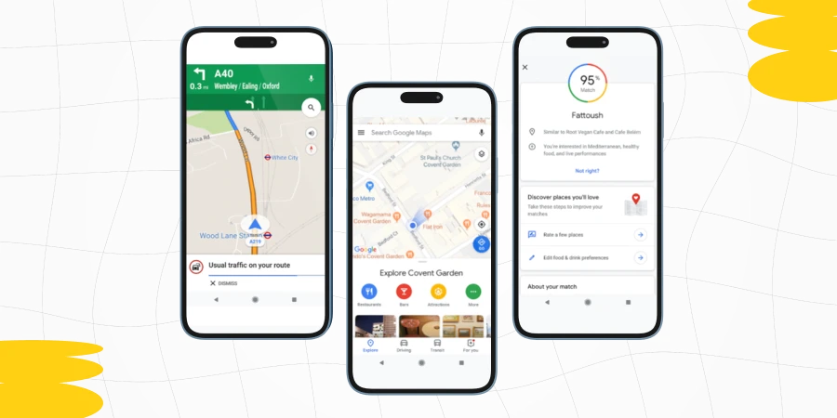
Jobs in
Web development
UI/UX
Ui (user interface) : refers to the screens, buttons, toggles, icons, and other visual elements that you interact with when using a website, app, or other electronic device.
Ux (user experience): UX refers to the entire interaction you have with a product, including how you feel about the interaction
Page
08

Slide 8
Jobs in
Web development
Project Manager
LA project manager is a professional who organizes, plans, and executes projects while working within restraints like budgets and schedules. Project managers lead entire teams, define project goals, communicate with stakeholders, and see a project through to its closure.
Tasks and responsibilities
Defining the scope of the project
Staying on schedule
Planning a project’s cost .
Managing project resources (including teams and workers)
Documenting the progress of the project
Communicating with stakeholders
Page
08

Slide 9

Jobs in
Web development
Quality assuransce and Quality control
quality assurance and quality control
QA: Focuses on improving processes to prevent problems before they arise.
QC: Focuses on inspecting the finished product to detect defects after it has been produced.
Page
08

Slide 10
Jobs in
Web development
Mobile developer
People who design and prepare software for smartphones and other mobile devices are called mobile app developers.
Workplace
A mobile app developer may work for large technology companies or small startups. Some developers work for themselves from home.
Mobile app developer salary
The hourly wage for a mobile app developer varies widely from $21 to $150 per hour, depending on experience and location. The national average salary in 2018 was about $100,000 per year. But individual jobs may pay much more or much less.
Soft Skills
1)Patience
2)Good at working with other team members
3)Ability to work on several different projects at the same time
Page
08

Slide 11

Jobs in
Web development
Mobile developer
Technical Skills
***Native
1)Swift (ios)
2)Objective-c (ios)
3)Kotlin
4)Java
***Frame Work
1)Flutter
2)React Native (Js)

Slide 12
Jobs in
Web development
DevOps
:It’s a Software development methodology:
It accelerates the delivery of higher-quality applications and services by combining and automating the work of software development and IT operations teams. With shared tools and practices
·Coding: code development and unit testing
·Building: process of continually integrating work from multiple developers
·Testing: process of testing the new patches and finding bugs and errors in either code or the product
·Packaging :create packaging and patches that can be released
·Configuration

Slide 13
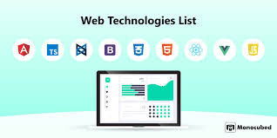
Most popular
technologies in the web
The Most popular technologies on the web: When we are talking about web development technologies, it usually means the client-side technologies, which are used to build and display everything that the end-user interacts with. The main language of the web is JavaScript ,means that the web technologies are mostly based on JavaScript, while server-side technologies are varied (.NET, Java, PHP, Ruby, or even server-side JavaScript Node.js).
Page
09

Slide 14



Popular web technologies
Angular: Angular is a TypeScript-based, open-source, front-end mobile and web application framework developed by Google in 2010.
React: React is an open-source, front-end JavaScript library for creating interactive UIs. React is developed and maintained by Facebook and a large community of dedicated developers.
Page
05

Slide 15


Popular web technologies
Vue.js:Vue.js is an open-source MVVM (Model-View-ViewModel), front-end JavaScript framework for building web UIs and single-page applications.
Flutter for web :Flutter’s a free, open-source mobile UI framework developed by Google for building fast and expressive native apps. Flutter can also be used for web content using standards-based web development technologies: HTML, CSS, and JavaScript.
Page
05

Slide 16
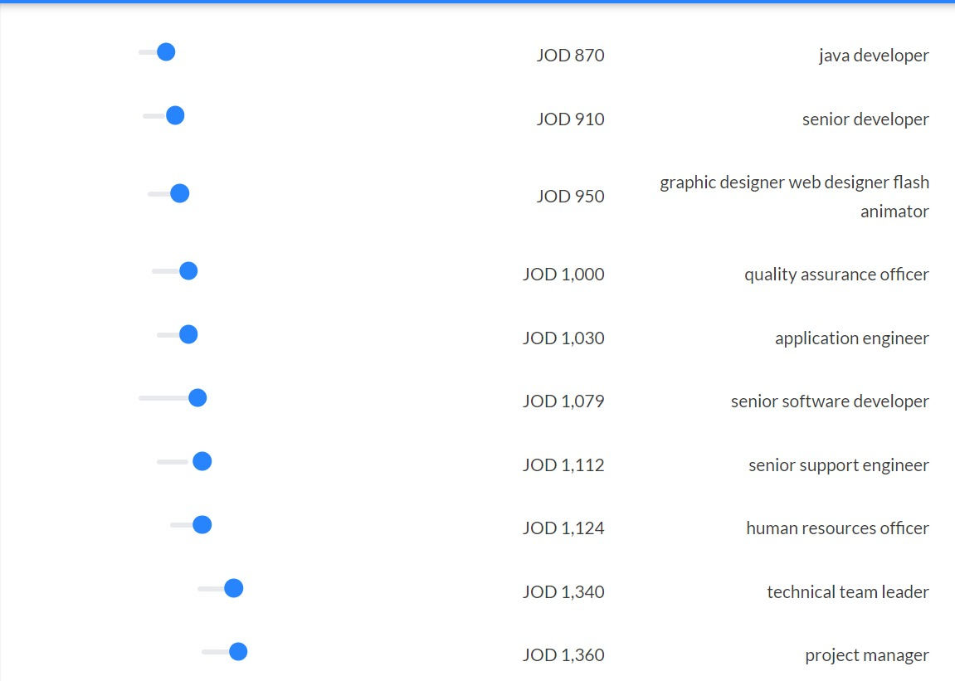
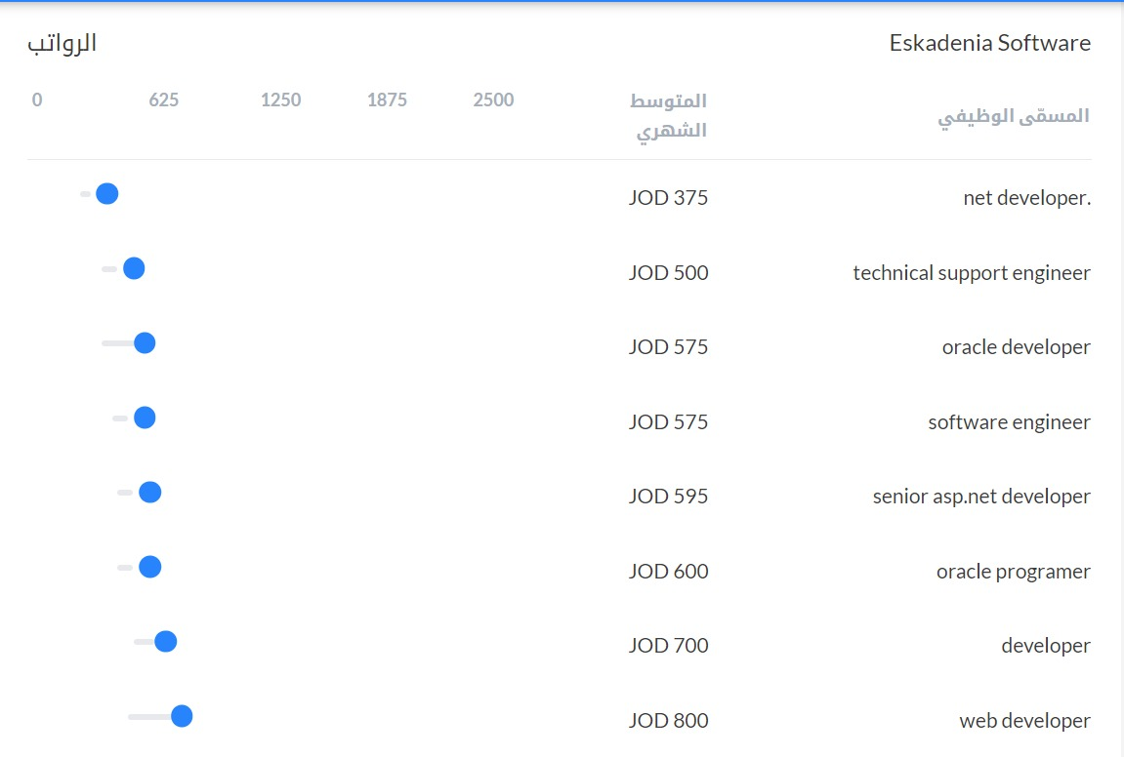
Salaries in
Web development
salaries in web development vary depending on years of experience and the position itself
Page
06

Slide 17
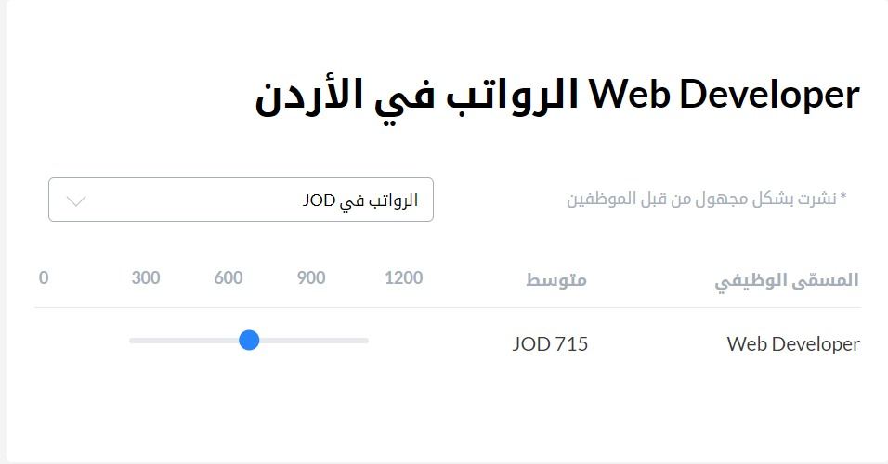
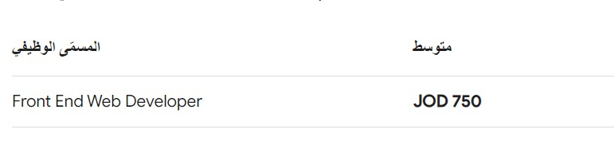
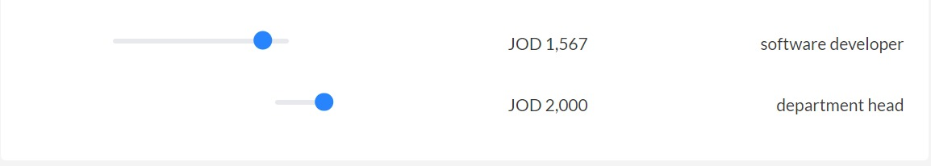
Salaries in
Web development

Slide 18
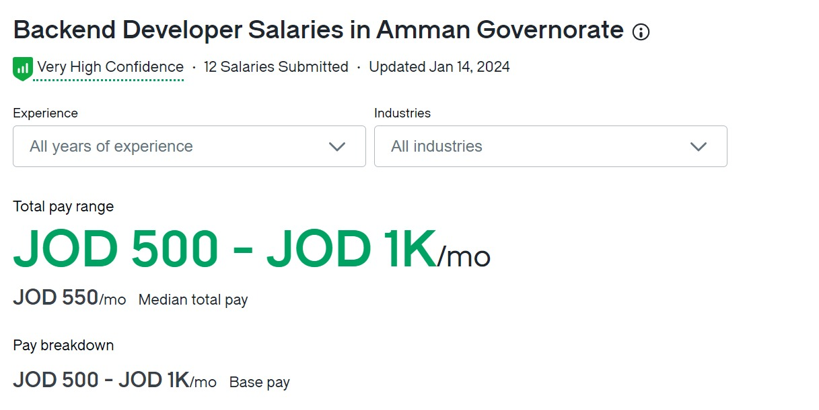
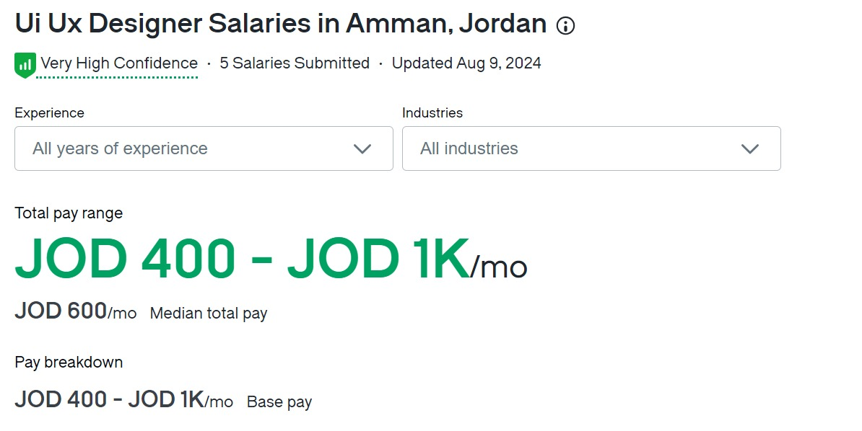
Salaries in
Web development

Slide 19
Salaries in
Web development

Slide 20
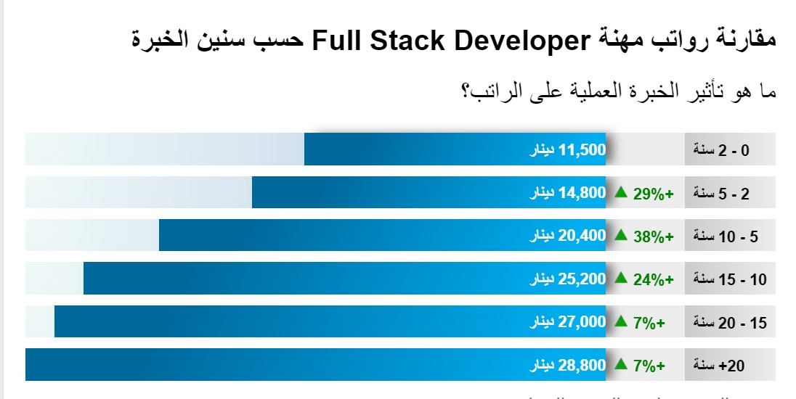
Salaries in
Web development

Slide 21
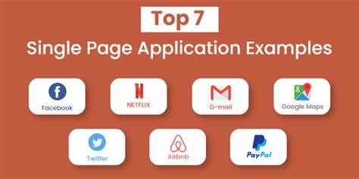
Most demmanded
field in Web development
1-Proficiency in javascript frameworks
it split into 3 frameworks;
1-react is used mostly for SPA (single page application)
2-Angular developed by google for dynamic web application (facebook google maps airbnb)
3-vue.js:Library for building interactive web interfaces using simple api view layer only and not full blown.
2-expertise in front end develpoment;
-HTML/CSS
-Responsive Design
-Beta test
Page
09

Slide 22

Most demmanded
field in Web development
3-mastery of backend:
-Node.js
-Ruby on rails usage:
· Rendering HTML templates
· Updating databases
· Sending and receiving emails
-SQL
4-embracing new technologies in web development
-SPA
-PWA (progressive web apps) combining the best of web and mobile apps
6-brief understanding of UI/UX
7-block chain
Blockchain is an encrypted database storing system, Blockchain technology enables the participants to make transactions across the internet without the interference of a third party.
Page
09

Slide 23
Thank
You.
Omar
Ahmad
Rania
Husam
Musa
Oroub
Loay
Page
10

